Slide 1
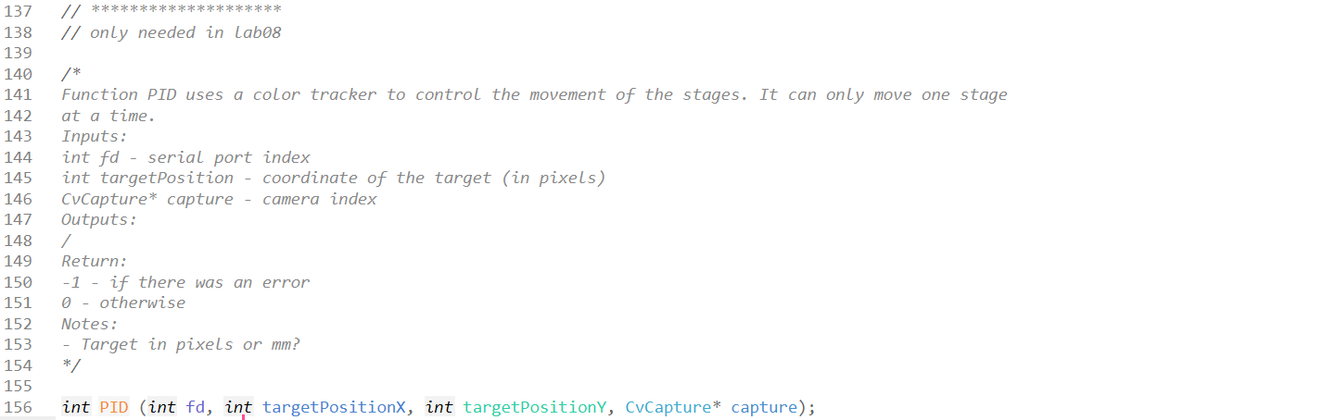
Introduction to Robotics and Mechatronics
GROUP 2.5
Benson Chalethu
Pietro Griffa
Ingvar Groza
PreLab 08
Q1
closedLoopControl.h
For the first part of the code please see closedLoopControl.h in PostLabo07

Slide 2
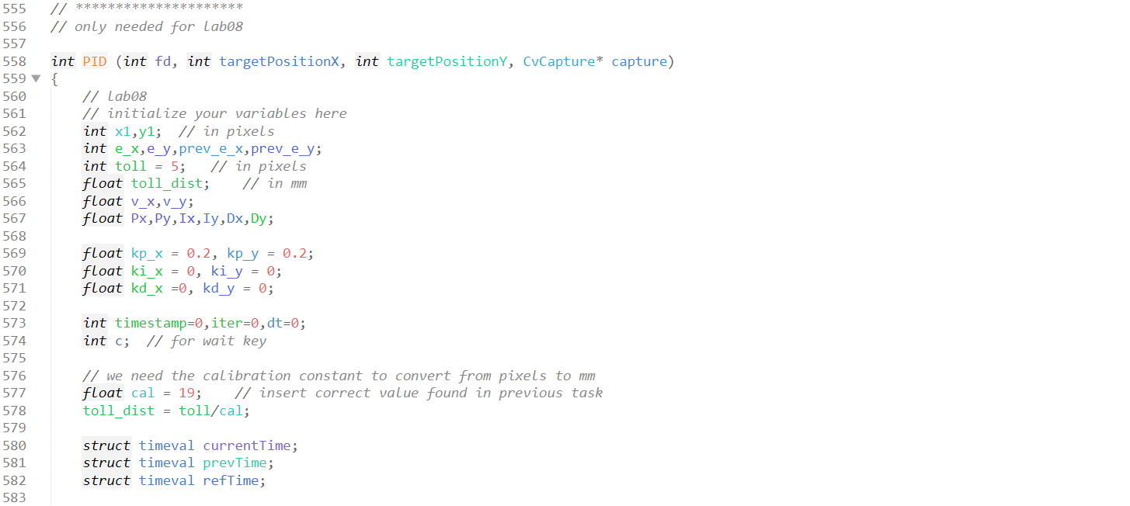
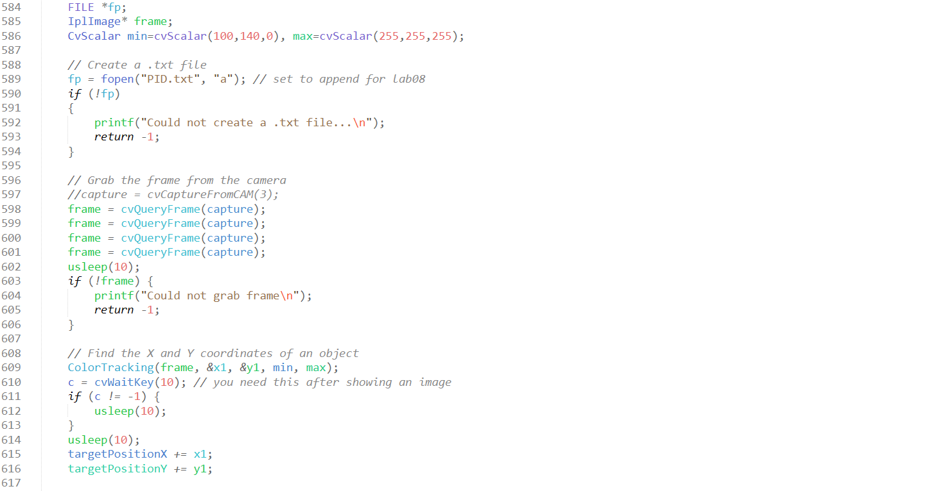
Q1
closedLoopControl.c
For the first part of the code please see closedLoopControl.c in PostLabo07

Slide 3
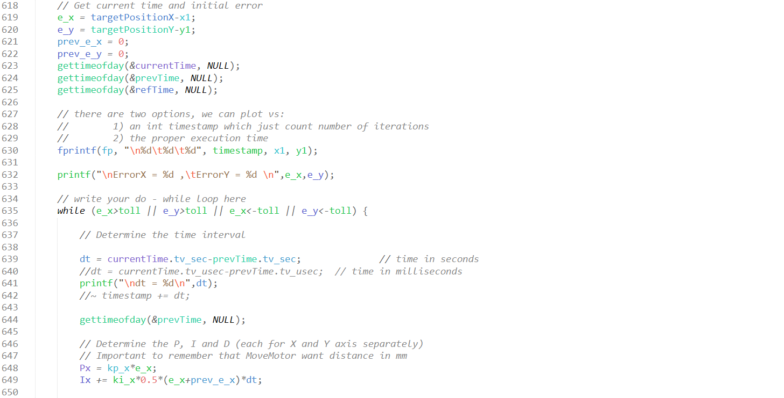
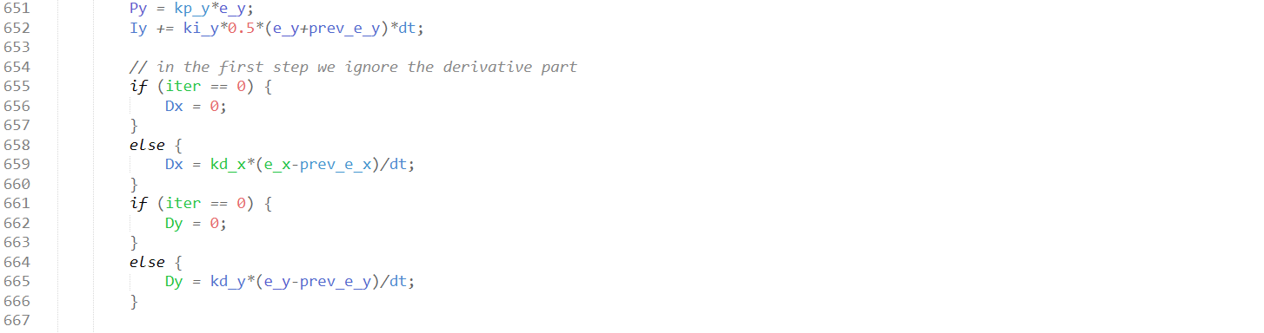
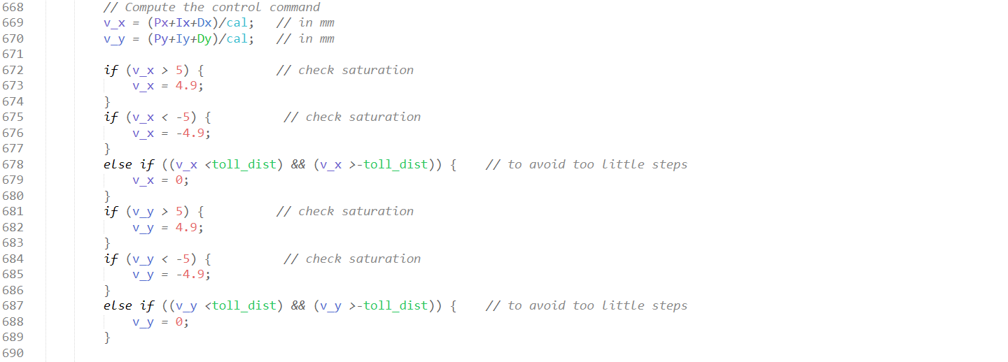
Q1

Slide 4
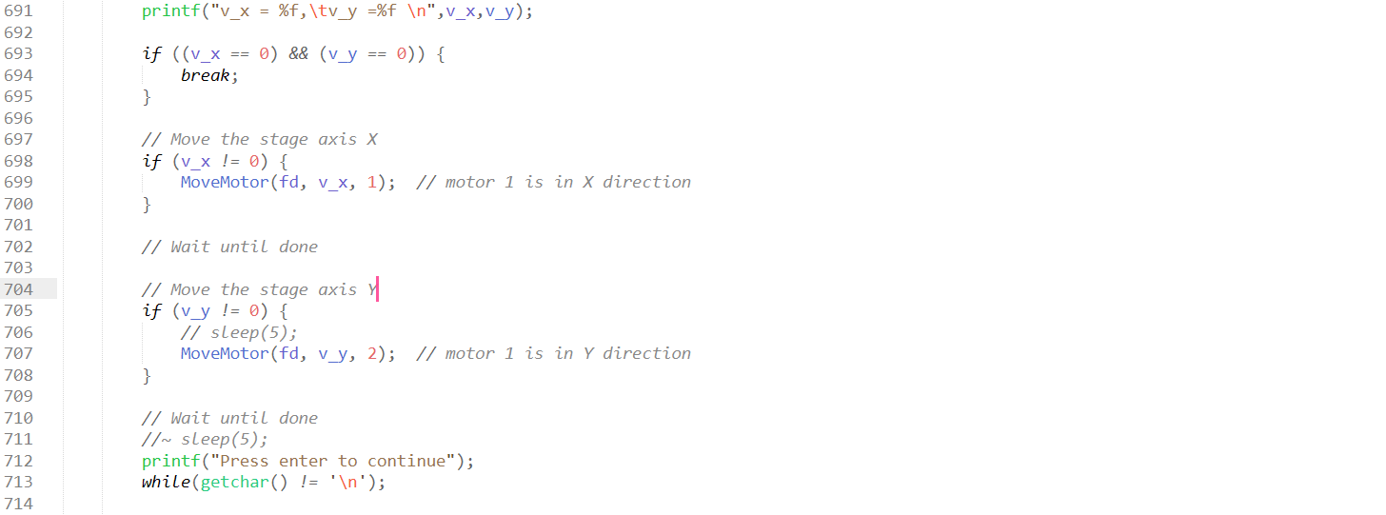

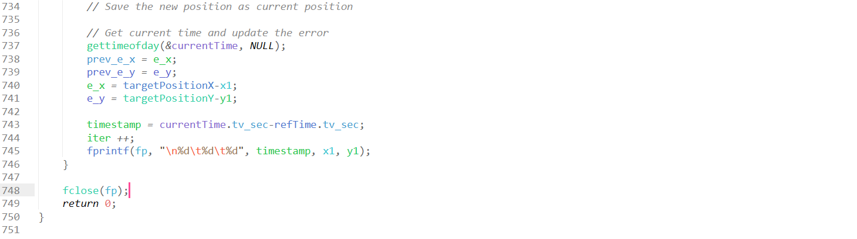
Q1

